Slide 1
Mrs. Henry

Slide 2
Grandfather - James Mason Served in the U.S. Navy during World War I. He never talked of his experiences. Uncle - James Mason II Joined the navy during World War II. Every time he talked about it, he cried about the friends he had lost, and the terrible things he had seen. Cousin - James B. Mason III (not pictured) A marine in the Vietnam war. Like our grandfather, he would never talk about what happened to him in the war.

Slide 3
When we remember our soldiers we should also remember our allies. This is a picture of my father, John Hedworth, a captain in the English Merchant Navy. He and his crew were responsible for shipping supplies between England and the U.S. throughout the war, often having to dodge German submarines in the process.

Slide 4
He met my mother Phyllis when his ship came into the port of New York City. They married and moved to England towards the end of the war. This is their wedding picture. My father died six months before I was born.

Slide 5
My mother returned to NY after the war, and I was born here. When I was two years old, she planned to take me to visit my English family. This is our passport picture. My mother was killed in a car accident the night before we were to leave. The person driving her home was drunk.

Slide 6
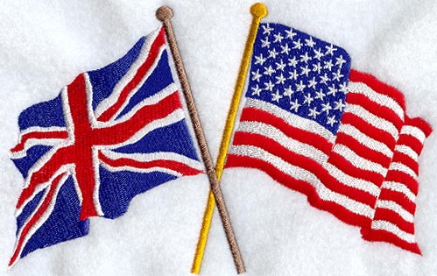
I visited my English family many times as a child, and later with my husband. Every time we visited, men and women of my parents’ generation thanked us as Americans for helping them. They were certain that the Germans would have taken control of Britain, if the United States had not entered the war. They asked us to thank every World War II veteran we knew for their extreme sacrifice. They said they would never forget. Neither should we.

